Slide 1
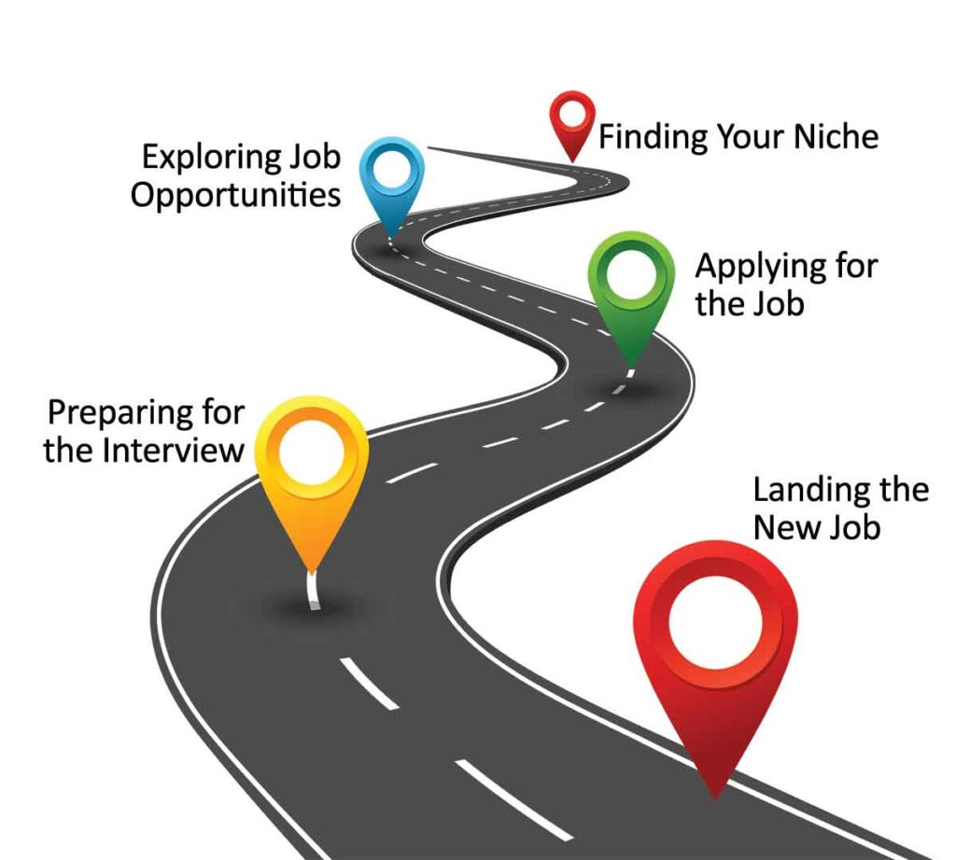
Your Pathway to Success

Slide 2
Resume:
Simple but Strong
About you
Basic Details
Photograph
Skills
Achievements

Slide 3
Interview
Introduce yourself in impressive manner highlighting your achievements
Language/Practice: verbal/posture/confidence
Personal Appearance
Availability. Don’t be Late.
Listen Carefully.
Give descriptive answers.
Ask for Improvement suggestions.

Slide 4
Contextual knowledge
Know about company
Know about you
Job Description
Why should hire you
Your goals

Slide 5
Technical Knowledge
Subjective
Logical/Analytical
Trending in industry
General Interview Questions
Competitive Coding
Certifications and Trainings

Slide 6
Body language: do’s and don’ts
DON’T
Limp/clammy handshake
Wear jeans
Look down
Cross arms(?)
Flop into chair
Wave arms
Stare out of window
Shake with nerves
DO
Firm handshake
Eye contact
Smile!
Open posture
Relaxed, but alert
Look neat & professional
Adopt appropriate dress code
Listen actively – ‘head nods’
Sit in the right seat
Be prepare

Slide 7
Post Interview:
Review the discussion
Make a note
Learn From Every Interview
Ask for feedback on email

Slide 8
New Bae in Job
Prepare your introduction
Professional attire
Make connections/ Socilalize
Remember Names
Ask well-timed questions
Make notes of everything
Be proactive/Thankful/approachable/humble
Spent time in Learning
Be organised
Have regular connect & feedback with manager
Challenge yourself
Avoid office gossip
Adapt company culture/ Proactively participate in events
Identify your goal
Set up a three-month review
Avoid personal calls

Slide 9

Questions?

